Slide 1
Oversampling

Slide 2
Case-Control Sampling

Slide 3
Is there such a thing as too much data?

Slide 4
The two-sample t-test

Slide 5
Big Data and p-values
proc power;
twosamplemeans
groupmeans = (120 122)
stddev=20
power=.
groupns=(500 9500) (5000 95000) (50000 950000);
run;

Slide 6
Big Data and p-values
proc power;
twosamplemeans
groupmeans = (120 122)
stddev=20
power=.
groupns=(500 500) (5000 5000) (50000 50000);
run;

Slide 7
Big Data and p-values
proc power;
twosamplemeans
groupmeans = (120 122)
stddev=20
power=.
groupns=(500 2500) (5000 25000) (50000 250000);
run;

Slide 8
The logistic model with over sampling.

Slide 9
The Logistic Model

Slide 10
This assumes that we have a random sample from a population

Slide 11
Cohort Sampling
Joint
(x,y),(x,y),(x,y),
(x,y),(x,y),(x,y),
(x,y),(x,y),(x,y),
(x,y),(x,y),...
{(x,y),(x,y),(x,y),(x,y)}
Population
Sample

Slide 12
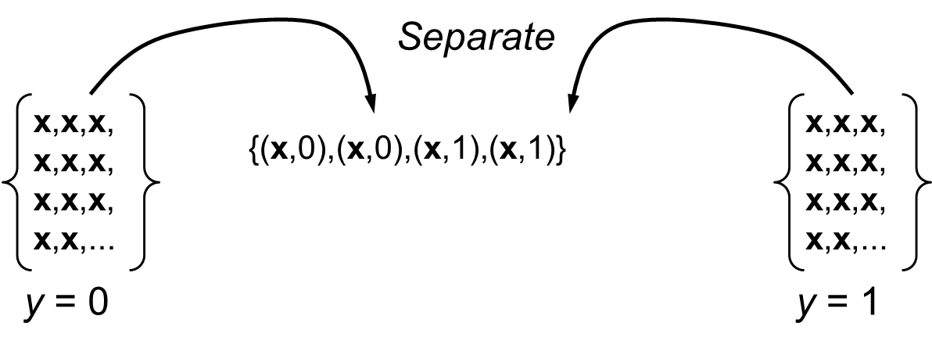
Case-control sampling – over sampling
Sampling is conditional on y, so the previous likelihood is no longer appropriate. (Binary outcome fixed by stratification.)

Slide 13
$$s=\left\{\begin{matrix}0 \text{Observation} \text{not} \text{selected} \\ 1 \text{Observation} \text{selected} \end{matrix}\right.$$
$$\begin{matrix}n_{1} \text{The} \text{number} \text{selected} \text{with} y=1 \\ n_{0} \text{The} \text{number} \text{selected} \text{with} y=0\end{matrix}$$
$$\begin{matrix}\text{Full} \text{Likelihood}\text{:} \\ \prod_{i=1}^{n_{1}}{\left.Pr(x_{i}|y_{i}=1,s_{i}=1\right)}\prod_{i=1}^{n_{0}}{\left.Pr(x_{i}|y_{i}=0,s_{i}=1\right)}\end{matrix}$$

Slide 14
$$\begin{matrix}\text{Let}\text{:} \\ \left.τ_{1}=Pr(s=1|y=1,x)=Pr(s=1|y=1\right) \\ \left.τ_{0}=Pr(s=1|y=0,x)=Pr(s=1|y=0\right) \\ \left(\text{sampling} \text{is} \text{independent} \text{of} x\right)\end{matrix}$$
A couple of applications of Bayes Theorem and some algebra demonstrates

Slide 16
If we treat the data as if they came from cohort sampling we get the correct estimates, except for the intercept.
The intercept being incorrect means we don’t get the correct estimates of probabilities.

Slide 17
Over-sampling in “Big Data.”

Slide 18
Case-Control Sampling, an example
proc freq data=a.chd2018_a;
tables chd;
run;

Slide 19
Select 100% of cases.
proc sql;
create table cases as
select *
from a.chd2018_a
where chd=1;
quit;

Slide 20
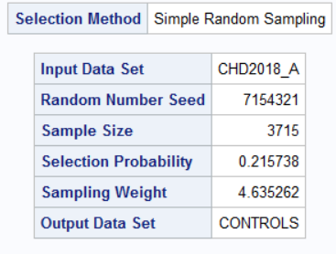
Select one control for each case.
proc surveyselect data=a.chd2018_a
n=3715
out=controls
method=srs seed=7154321;
where chd=0;
run;

Slide 21
Create the case-control study.
data casecontrol;
set cases controls;
run;
proc freq data=casecontrol;
tables chd;
run;

Slide 22
Logistic regression
ods select parameterestimates;
proc logistic data=a.chd2018_a descending;
model chd=age sbp;
title “Original data";
run;
ods select parameterestimates;
proc logistic data=casecontrol descending;
model chd=age sbp;
title "Case-control sampling";
run;
title;

Slide 23
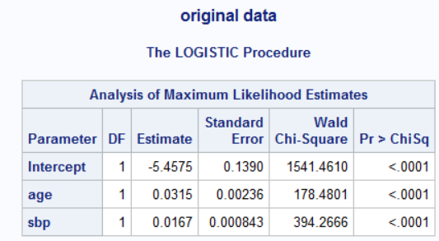
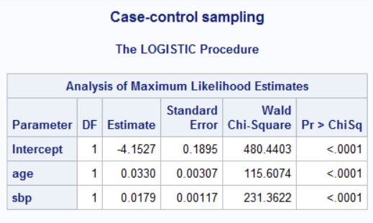

Slide 24
Note estimated probabilities
ods select parameterestimates;
proc logistic data=casecontrol descending;
model chd=age sbp;
title "Case-control sampling";
score data=casecontrol out=scored;
run;
title;
proc means data=scored;
var p_1;
run;

Slide 25
Adjust estimated probabilities for over sampling.
/*adjusted for oversampling*/
ods select parameterestimates;
proc logistic data=casecontrol descending;
model chd=age sbp;
title "Case-control sampling";
score data=casecontrol out=scored priorevent=.1775;
run;
title;
proc means data=scored;
var p_1;
run;

