Slide 1
An initial examination.

Slide 2
proc contents data=d.develop;
run;

Slide 3
Initial examination of numeric data
proc means data=d.develop n nmiss min max mean median std;
run;

Slide 4
Examine number of unique values.

Slide 5
A note on “meta” data Dictionary tables

Slide 6
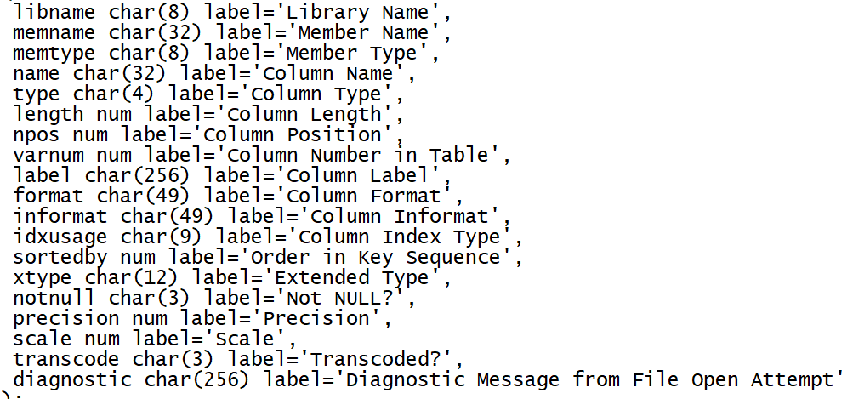
proc sql;
describe table dictionary.columns;
quit;

Slide 7
Get variable names on the file into a macro variable.
libname d "d:\dropbox\develop\_data";
proc sql;
select name into : varnames separated by " "
from dictionary.columns
where libname="D" and memname="DEVELOP";
quit;
%put &varnames;

Slide 8
Examine structure of data with proc freq
ods output nlevels=d.DevelopLevels;
proc freq data=d.develop nlevels;
tables &varnames/noprint;
run;
proc print data=d.DevelopLevels;
run;

Slide 9
A simple variable screen, 0,1 categorical variables with no missing values.

Slide 10
Get names of 0,1 variables with no missing
proc sql;
select tablevar into : zeroone separated by " "
from d.DevelopLevels
where NLevels=2 and NMissLevels=0 and tablevar ne "Ins"
;
quit;
%put &zeroone;

Slide 11
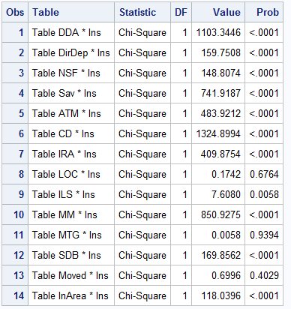
Crosstabs for 0,1 variables
ods output chisq=chisquares(where=(statistic="Chi-Square"));
proc freq data=d.develop;
tables (&zeroone)*ins/nocol nopercent chisq;
run;
proc print data=chisquares;
run;

Slide 12
Find variables to drop.
proc sql;
select scan(table,2) into : todrop
separated by " "
from chisquares
where prob>.25;
;
quit;
%put &todrop;
Drop the variables and create analytic data set.
data d.develop_a;
set d.develop(drop=&todrop);
run;

