Slide 1
Missing Data

Slide 2
Choices: Complete Case Imputation

Slide 3
Complete-case analysis has attractive theoretical properties even when the missingness depends on observed values of other inputs.
Complete-case analysis has serious practical shortcomings with regards to predictive modeling.

Slide 4
The essential question – is scoring all new cases (even with missing data) to be required?

Slide 5
A reasonable strategy for handling missing values in predictive modeling
Create missing indicators and treat them as new input variables in the analysis.
Use median imputation for numeric inputs. Fill the missing value of x_{j} with the median of the complete cases for that variable.
Create a new level representing missing (unknown) for categorical inputs.

Slide 6
With this strategy a new case is easily scored.
Replace the missing values with the medians from the development data and then apply the prediction model.

Slide 7
Some notes (from a SAS document on predictive modeling)
There is a large statistical literature concerning different missing value imputation methods, including discussions of the demerits of mean and median imputation and missing indicators (Donner 1982, Jones 1997).
Most of the advice is based on considerations that are peripheral to predictive modeling.
There is very little advice when the functional form of the model is not assumed to be perfectly specified, when the goal is to get good predictions that can be practically applied to new cases, when p‑values and hypothesis tests are of secondary importance, and when the missingness might be highly pathological, in other words, depending on lurking predictors.

Slide 8
A note on complete case analysis for this data set.

Slide 9
proc sql;
select name,type
from dictionary.columns
where libname="D" and memname="DEVELOP";
select name into : vars separated by ","
from dictionary.columns
where libname="D" and memname="DEVELOP" and type="num"
;
quit;
%put &vars;
data tmp(keep=nummiss);
set d.develop;
nummiss=nmiss(&vars);
run;
proc freq data=tmp;
tables nummiss;
run;

Slide 10
proc sql;
select * from d.developlevels
;
select count(*) from d.developlevels
where nmisslevels ne 0
;
select tablevar into : missvars separated by " "
from d.developlevels
where nmisslevels ne 0
;
quit;
%put &missvars;

Slide 11
Create imputation indicators
%let imputed=MIAcctAg MIPhone MIPOS MIPOSAmt
MIInv MIInvBal MICC MICCBal
MICCPurc MIIncome MIHMOwn MILORes
MIHMVal MIAge MICRScor;
data d.develop_a(drop=i);
set d.develop_a;
/* define the missing indicator variables */
array mi{*} &imputed;
array x{*} &missvars;
do i=1 to dim(mi);
mi{i}=(x{i}=.);
end;
run;
proc means data=d.develop_a;
var &imputed;
run;

Slide 12
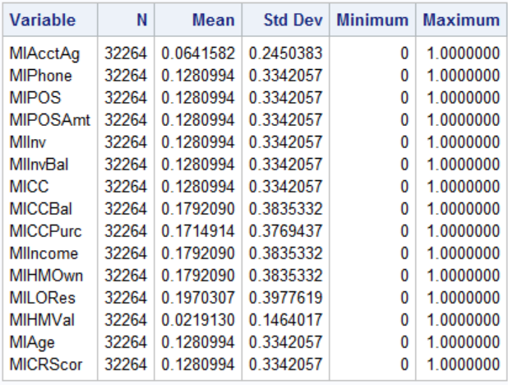

Slide 13
Now do median imputation.
proc stdize data=d.develop_a
reponly /*Replaces missing data with the location measure
(does not standardize the data)*/
method=median
out=d.imputed;
var &missvars;
run;
proc print data=d.imputed(obs=25);
var ccbal miccbal ccpurc miccpurc
income miincome hmown mihmown;
run;
proc means data=d.imputed nmiss;
run;

Slide 14
Other imputation possibilities, review.

Slide 15
Alternatives – Regression Imputation
Build k linear regression models, one for each input variable with missing data, using the other inputs as predictors. (k is the number of variables with missing values.)
Complication -- the other inputs may themselves have missing values => the k imputation regressions also need to accommodate missing values.

Slide 16
Alternatives – Cluster Imputation
Cluster the cases into relatively homogenous subgroups
Use mean-imputation within each group
For new cases with multiple missing values, use the cluster mean that is closest in all the nonmissing dimensions.

Slide 17
Alternatives – Form “logical” groups and use mean imputation within groups.

