Slide 1
Categorical Data

Slide 2
proc print data=d.developlevels;run;

Slide 3
Earlier, I Clustered Levels by hand using Greenacre’s method.
0
1
0
1
A
28
7
0
1
28
7
0
1
B
16
0
138
18
110
11
161
39
C
94
11
23
21
23
21
D
23
21
Merged:
B & C
A & BC
ABC & D
χ² =
31.7
30.7
28.6
0
100%
97%
90%
0%

Slide 4
Clustering Levels of Categorical Inputs with Proc Cluster
The levels of a categorical input can be clustered using Ward’s method with PROC CLUSTER.
Some simple pre-processing of the data is required.
Notes:
This demonstration illustrates using the FREQ statement and METHOD=WARD in PROC CLUSTER to perform level clustering. Much of the work is automatic when using the Output Delivery System.

Slide 5
Recreate the data
/*
To use proc means to get proportions and
frequencies, single observations work better
*/
data cluster(drop=num);
input level $ outcome num @@;
do i=1 to num;
output;
end;
datalines;
A 0 28 B 0 16 C 0 94 D 0 23
A 1 7 B 1 0 C 1 11 D 1 21
;
run;
proc freq data=cluster;
tables level*outcome/nocol nopercent chisq;
run;

Slide 6
The Process
Get percentage of 1’s by category
Use PROC CLUSTER to cluster categories using Ward’s method
Use data step to compute the the p-value for collapsed tables
Find the cluster solution with lowest p-value
Use the TREE procedure to produce a dendogram

Slide 7
Create a data set with the proportions of 1’s for each level.
/*
Get percentage of 1’s by level
*/
proc means data=cluster noprint nway;
class level;
var outcome;
output out=proportions mean=prop;
run;
proc print data=proportions;
run;

Slide 8
/*
Use Cluster to cluster levels using Greenacre’s method
*/
ods select clusterhistory;
ods output clusterhistory=clusters;
ods html off;
proc cluster data=proportions method=ward;
freq _freq_;
var prop;
id level;
run;
ods html on;
proc print data=clusters;
run;

Slide 9
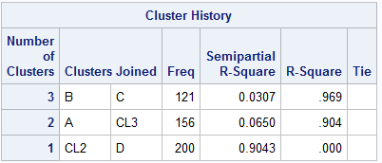
0
1
0
1
A
28
7
0
1
28
7
0
1
B
16
0
138
18
110
11
161
39
C
94
11
23
21
23
21
D
23
21
Merged:
B & C
A & BC
ABC & D
χ² =
31.7
30.7
28.6
0
100%
97%
90%
0%

Slide 10
Calculate log pvalues
/*
Compute the chi-square statistic for each
collapsed table.
*/
data pvals;
if _n_ = 1 then set chi;
set clusters;
chisquare=_pchi_*rsquared;
degfree=numberofclusters-1;
pvalue=1-cdf('chisq',chisquare,degfree);
logpvalue=logsdf('CHISQ',chisquare,degfree);
run;
proc print data=pvals;
run;

Slide 11
A more complex example – the branch variable, the develop data set.

Slide 12
proc freq data=d.imputed;
tables branch*ins/nocol nopercent;
run;

Slide 13
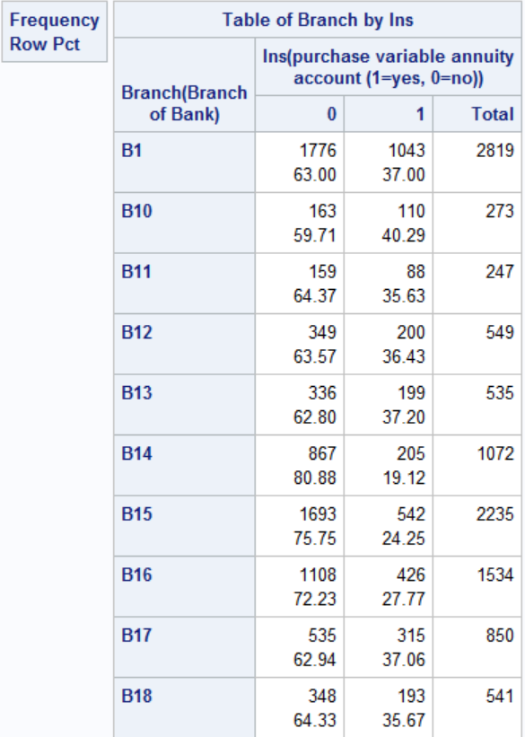
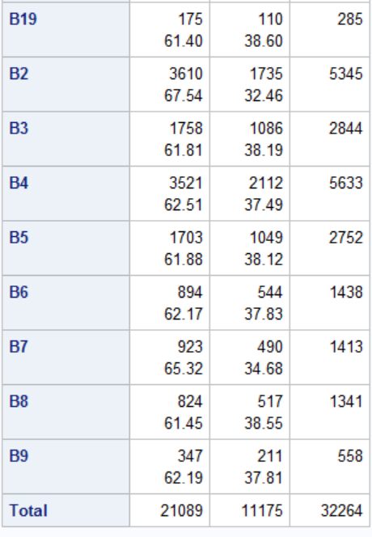

Slide 14
The Process
Get percentage of 1’s by category
Use PROC CLUSTER to cluster categories using Ward’s method
Use data step to compute the the p-value for collapsed tables
Find the cluster solution with lowest p-value
Use the TREE procedure to produce a dendogram

Slide 15
Get percentage of 1’s by branch
proc means data=d.imputed noprint nway;
class branch;
var ins;
output out=level mean=prop;
run;
proc print data=level;
run;

Slide 16
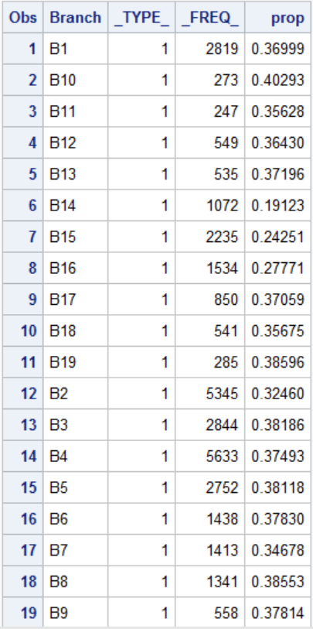

Slide 17
ods html close;
ods output clusterhistory=cluster;
proc cluster data=level method=ward;
freq _freq_;
var prop;
id branch;
run;
ods html;
proc print data=cluster;
run;

Slide 18
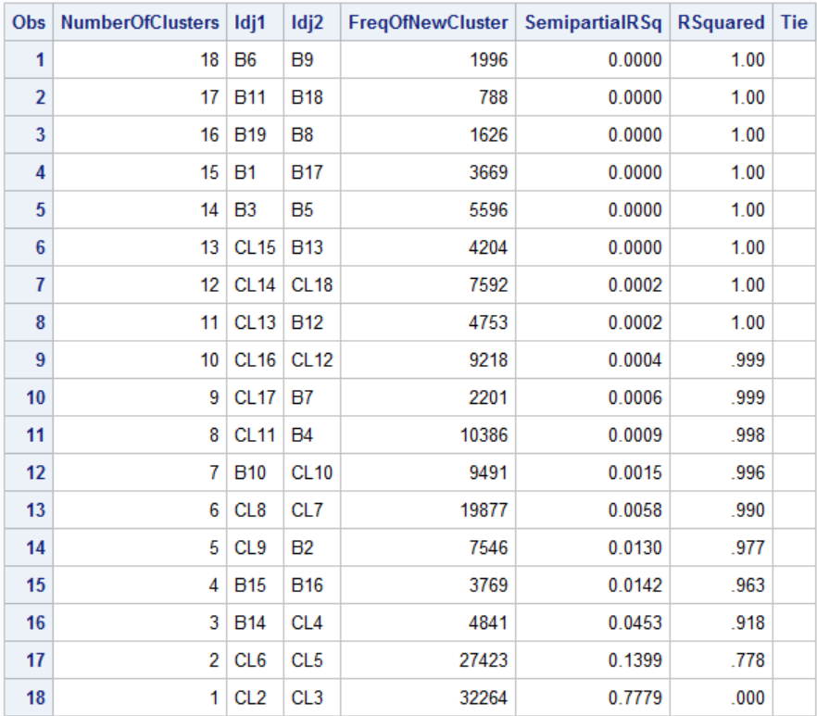
RSquared is equivalent to the proportion of chi-squared in the 19×2 contingency table remaining after the levels are collapsed
Semipartial RSq is change in chi-square

Slide 19
Rows are the results after the listed clusters were merged
When previously collapsed levels are merged, they are denoted using the CL as the prefix and the number of resulting clusters as the suffix. For example, at the sixth step, CL15 represents B1 and B17 that were merged at the fourth step creating 15 clusters

Slide 20
Find optimum number of cluster. First step get chi-square for 19 x 2 table.
proc freq data=d.imputed noprint;
tables branch*ins / chisq;
output out=chi(keep=_pchi_) chisq;
run;
proc print data=chi;
run;

Slide 21
Compute the chi-square statistic and log p-value for each collapsed contingency table.
data cutoff;
if _n_ = 1 then set chi;
set cluster;
chisquare=_pchi_*rsquared;
degfree=numberofclusters-1;
logpvalue=logsdf('CHISQ',chisquare,degfree);
run;
proc print data=cutoff;
run;

Slide 22
With a larger number of categories (such as branch in the develop data set) a plot of log p-values will be handy.

Slide 23
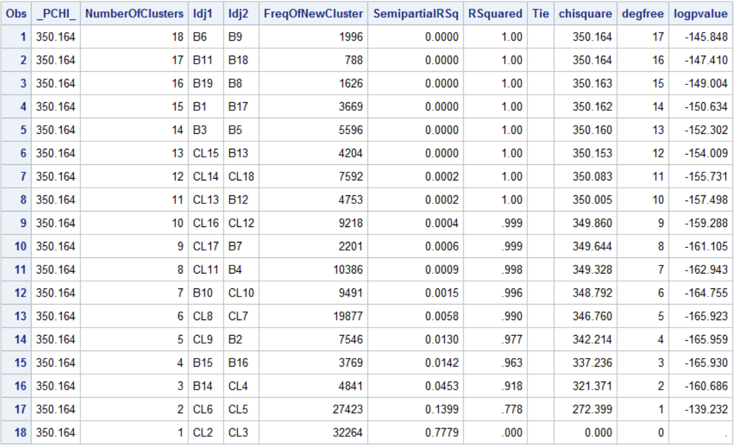

Slide 24
Plot log p value vs number of clusters.
proc sgplot data=cutoff;
scatter y=logpvalue x=numberofclusters
/ markerattrs=(color=blue symbol=circlefilled);
xaxis label="Number of Clusters";
yaxis label="Log of P-Value" min=-170 max=-130;
title "Plot of the Log of the P-Value by Number of Clusters";
run;
title;

Slide 25
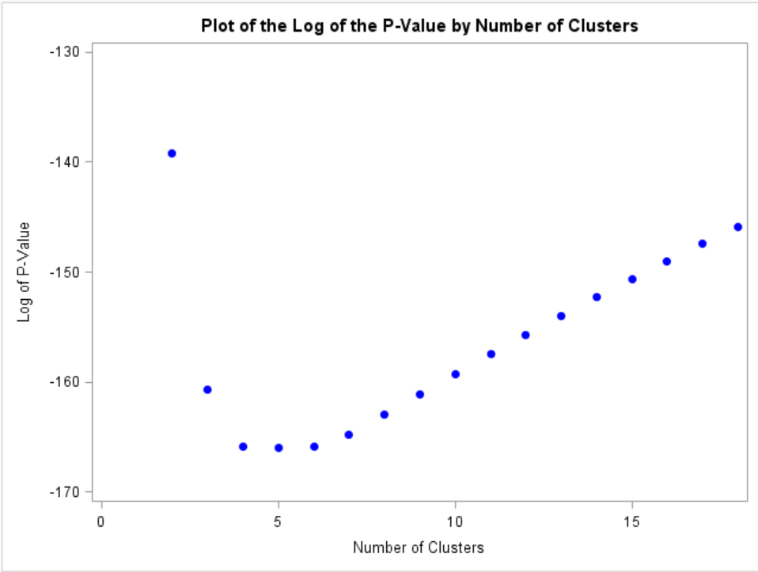

Slide 26
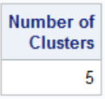
Create a macro variable with the number of clusters with the smallest p-value.
proc sql;
select NumberOfClusters into :ncl
from cutoff
having logpvalue=min(logpvalue);
quit;
%put "Optimum #clusters: " &ncl;

Slide 27
Add info for drawing a dendogram
ods html close;
ods output clusterhistory=cluster;
proc cluster data=level method=ward outtree=fortree;
freq _freq_;
var prop;
id branch;
run;
ods html;

Slide 28
Draw dendogram using PROC TREE
proc tree data=fortree h=rsq vaxis=axis1
nclusters=&ncl out=clus;
id branch;
axis1 label=("Proportion of Chi-Squared Statistic");
title "Tree Diagram of Branch of Bank";
run;

Slide 29
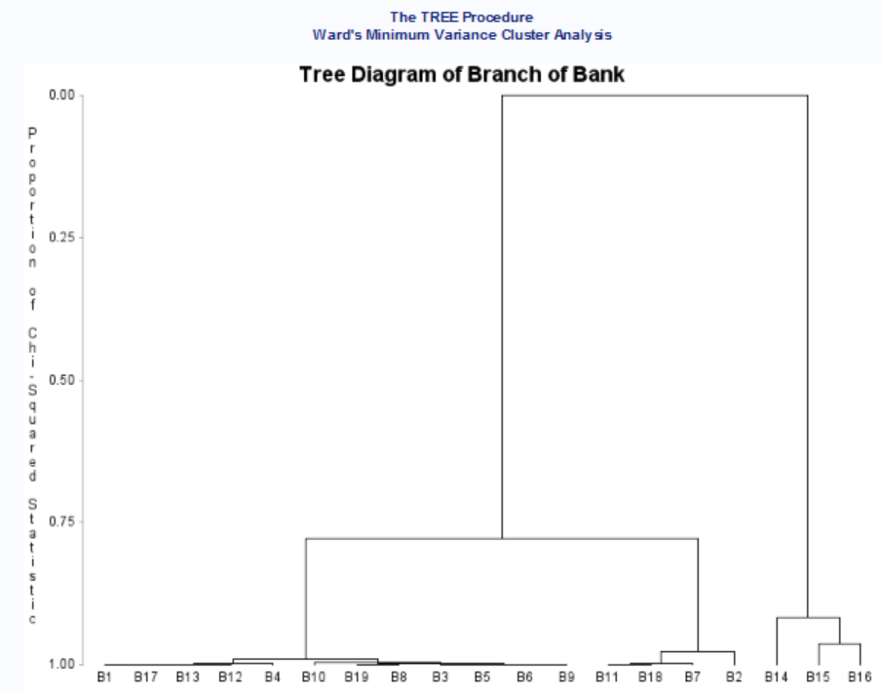

Slide 30
The five clusters
proc sort data=clus;
by clusname;
run;
proc print data=clus;
by clusname;
id clusname;
run;

Slide 31
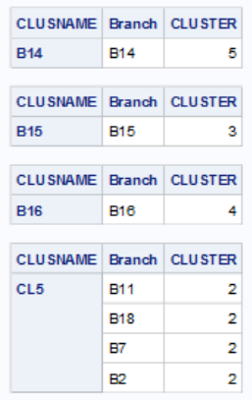
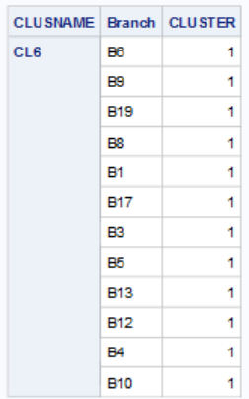

Slide 32
Add cluster variable to imputed data set
data d.develop_a;
set d.develop_a;
brclus1=branch in ('B6','B9','B19','B8','B1','B17',
'B3','B5','B13','B12','B4','B10');
brclus2=branch in ("B11","B18","B7","B2");
brclus3=(branch='B15');
brclus4=(branch='B16');
brclus5=(branch='B14');
run;

