Slide 1
Using results from PROC CORR for Variable Screening

Slide 2
Feature Engineering

Slide 3
The Spearman correlation statistic is the correlation of the ranks of the input variables with the binary target.
Hoeffding’s D detects a wide variety of associations between two variables.

Slide 4
Compare the results of the Spearman and Hoeffding paying attention to:
Neither measure shows a relationship – drop the variable. Decision based on p-value.
Hoeffding results in higher measure than Spearman – perhaps need some ”feature engineering”
Use ranking of measures for decisions.

Slide 5
The rank option in PROC CORR, some details

Slide 6
The set for consideration.
%let reduced=
MIPhone MICCBal Dep MM ILS MTGBal Income POS CD IRA
brclus1 Sav NSF Age SavBal LOCBal NSFAmt Inv MIHMVal CRScore
MIAcctAg InvBal DirDep CCPurc SDB CashBk AcctAge InArea ATMAmt DDABal
DDA brclus2 CC HMOwn DepAmt Phone ATM LORes brclus4;

Slide 7
The rank option in PROC CORR
%let reduced=
MIPhone MICCBal Dep MM ILS MTGBal Income POS CD IRA
brclus1 Sav NSF Age SavBal LOCBal NSFAmt Inv MIHMVal CRScore
MIAcctAg InvBal DirDep CCPurc SDB CashBk AcctAge InArea ATMAmt DDABal
DDA brclus2 CC HMOwn DepAmt Phone ATM LORes brclus4;
ods output spearmancorr=spearman
hoeffdingcorr=hoeffding;
proc corr data=d.develop_a spearman hoeffding rank;
var &reduced;
with ins;
run;

Slide 8
proc contents data=spearman;run;
proc print data=hoeffding;run;
The variable names in the SAS data sets Spearman and Hoeffding are in the variables best1 through best39
The correlation statistics are in the variables r1 through r39
The p-values are in the variables p1 through p39.

Slide 9
We need to restructure the data sets so the identifier is the variable name and there is a single observation for each variable name.
We also will want to keep the correlation means, its rank, and p-value for each observation (named to be different on the two data sets.

Slide 10
Restructure Spearman data
%let nvar=39;/*reduced set*/
data spearman1(keep=variable scorr spvalue ranksp);
length variable $ 8;
set spearman;
array best(*) best1--best&nvar;
array r(*) r1--r&nvar;
array p(*) p1--p&nvar;
do i=1 to dim(best);
variable=best(i);
scorr=r(i);
spvalue=p(i);
ranksp=i;
output;
end;
run;

Slide 11
Restructure Hoeffding data.
data hoeffding1(keep=variable hcorr hpvalue rankho);
length variable $ 8;
set hoeffding;
array best(*) best1--best&nvar;
array r(*) r1--r&nvar;
array p(*) p1--p&nvar;
do i=1 to dim(best);
variable=best(i);
hcorr=r(i);
hpvalue=p(i);
rankho=i;
output;
end;
run;

Slide 12
Merge the two data sets by variable name.
proc sort data=spearman1;
by variable;
run;
proc sort data=hoeffding1;
by variable;
run;
data correlations;
merge spearman1 hoeffding1;
by variable;
run;

Slide 13
Print results
proc sort data=correlations;
by ranksp;
run;
proc print data=correlations label split='*';
var variable ranksp rankho scorr spvalue hcorr hpvalue;
label ranksp = 'Spearman rank*of variables'
scorr = 'Spearman Correlation'
spvalue = 'Spearman p-value'
rankho = 'Hoeffding rank*of variables'
hcorr = 'Hoeffding Correlation'
hpvalue = 'Hoeffding p-value';
title "Rank of Spearman Correlations and Hoeffding Correlations";
run;
Title;

Slide 14
A low rank means a low p-value If the Spearman rank is high but the Hoeffding’s D rank is low, then there may be an association that is probably not monotonic. (Empirical logit plots can be used to investigate this type of relationship.) A graph might help.

Slide 15
Get some values to draw reference lines
proc sql noprint;
select min(ranksp) into :vref
from (select ranksp
from correlations
having spvalue > .5);
select min(rankho) into :href
from (select rankho
from correlations
having hpvalue > .5);
quit;

Slide 16
Plot rank of Spearman vs rank of Hoeffding
proc sgplot data=correlations;
refline &vref / axis=y;
refline &href / axis=x;
scatter y=ranksp x=rankho / datalabel=variable;
yaxis label="Rank of Spearman";
xaxis label="Rank of Hoeffding";
title "Scatter Plot of the Ranks of Spearman vs. Hoeffding";
run;
title ;

Slide 17
In general, the upper right corner of the plot contains the names of variables that could reasonably be excluded from further analysis, due to their poor rank on both metrics. The criterion to use in eliminating variables is a subjective decision.
Four variables are eliminated from the analysis: hmown, mtgbal, Miccbal, locbal
High ranks for Spearman and low ranks for Hoeffding’s D are found for the variables DDABal, DepAmt, and ATMAmt. Even though these variables do not have a monotonic relationship with Ins, some other type of relationship is detected by Hoeffding’s D statistic. Empirical logit plots should be used to examine these relationships.

Slide 18
The variables remaining
%let screened=
MIPhone Dep MM ILS Income POS CD IRA
brclus1 Sav NSF Age SavBal NSFAmt Inv MIHMVal CRScore
MIAcctAg InvBal DirDep CCPurc SDB CashBk AcctAge InArea ATMAmt DDABal
DDA brclus2 CC DepAmt Phone ATM LORes brclus4;

Slide 19
Investigate DDABal.

Slide 20
Empirical Logits
where
m_{i}= number of events
M_{i} = number of observations

Slide 21
A new macro PlotLogitsSeries
%macro PlotLogitsSeries(indata=,numgrp=7,indepvar=,depvar=);
proc rank data=&indata groups=&numgrp out=Ranks;
var &indepvar;
ranks Bin;
run;
proc sql;
create table toplot as
select
avg(&indepvar) as mean label="Mean of group",
sum(&depvar) as num_chd label="Number of Events",
count(*) as binsize label="Number at Risk",
log((calculated num_chd+1)/
(calculated binsize-calculated num_chd+1)) as logit
from ranks
group by bin;
quit;
proc sgplot data=toplot;
series x=mean y=logit/markers;
reg x=mean y=logit;
title "Estimated Logit Plot &indepvar, &numgrp groups";
run;
title;
%mend PlotLogitsSeries;

Slide 22
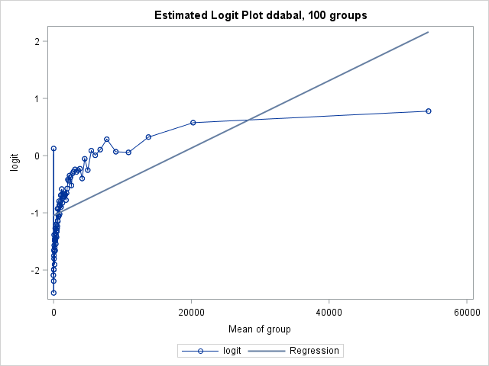
%PlotLogitsSeries(indata=d.develop_a,numgrp=100,indepvar=ddabal,depvar=ins);
There is a spike in the logits at the $0 balance level. Aside from that spike, the trend is monotonic but certainly not linear.

Slide 23
Examining means a little more closely -- the spike at $0
proc means data= d.develop;
class dda;
var ddabal;
run;

Slide 24
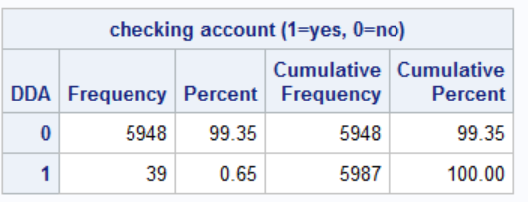
proc freq data=d.develop;
where ddabal=0;
tables dda;
run;

Slide 25
Most of the individuals with exactly $0 balances do not have checking accounts. It turns out that their balances have been set to $0 as part of the data pre-processing.
This rule seems reasonable from a logical imputation standpoint, less so for analysis.
The logit plot suggests that those individuals with 0 balance are behaving like people with much more than $0 in their checking accounts.

Slide 26
Impute ddabal and add a new variable to d.develop_a.

Slide 27
proc sql;
select mean(ddabal) into : mnbal
from d.develop_a
where dda eq 1
;
quit;
%put &mnbal;
data d.develop_a;
set d.develop_a;
imputed_ddabal=ddabal;
if dda = 0 then imputed_ddabal=&mnbal;
run;
proc means data=d.develop_a;
var ddabal imputed_ddabal;
run;

Slide 28
%PlotLogitsSeries(indata=d.develop_a,numgrp=100,
indepvar=imputed_ddabal,depvar=ins);

Slide 29
Plot logits by bin rather than mean

Slide 30
%let indata=d.develop_a;
%let numgrp=100;
%let indepvar=imputed_ddabal;
%let depvar=ins;
proc rank data=&indata groups=&numgrp out=Ranks;
var &indepvar;
ranks Bin;
run;
proc sql;
create table toplot as
select
bin label="Bin number",
avg(&indepvar) as mean label="Mean of group",
sum(&depvar) as num_chd label="Number of Events",
count(*) as binsize label="Number at Risk",
log((calculated num_chd+1)/
(calculated binsize-calculated num_chd+1)) as logit
from ranks
group by bin;
quit;
proc sort data=toplot;by bin;run;
proc sgplot data=toplot;
series x=bin y=logit/markers;
reg x=bin y=logit;
title "Estimated Logit Plot &indepvar, &numgrp groups";
title2 "Using bin number rather than mean";
run;
title;

Slide 31
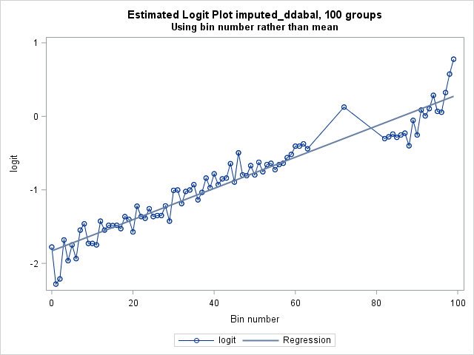

Slide 32
Some more "feature engineering"
To use imputed_ddabal “bins” for scoring new cases can perhaps best
be done using percentiles of the distribution.

Slide 33
First get the information for 100 bins
proc rank data=d.develop_a groups=100 out=out;
var imputed_ddabal;
ranks bin;
run;
title;
proc means data = out noprint nway;
class bin;
var imputed_ddabal;
output out=endpts max=max;
run;
proc print data = endpts;
run;

Slide 34
Using this information isn’t difficult, but requires a lot of code.
Using a select construct requires that we write a line of code for each
endpoint.

Slide 35
A program to write the necessary code
filename rank "C:\tmp\rank.sas";
data _null_;
file rank;
set endpts end=last;
if _n_ = 1 then put "select;";
if not last then do;
put " when (imputed_ddabal <= " max ") B_DDABal =" bin ";";
end;
else if last then do;
put " otherwise B_DDABal =" bin ";";
put "end;";
end;
run;

Slide 36
A program that uses the code
data d.develop_a;
set d.develop_a;
%include rank / source;
run;
proc means data = d.develop_a min max;
class B_DDABal;
var imputed_DDABal;
run;

Slide 37
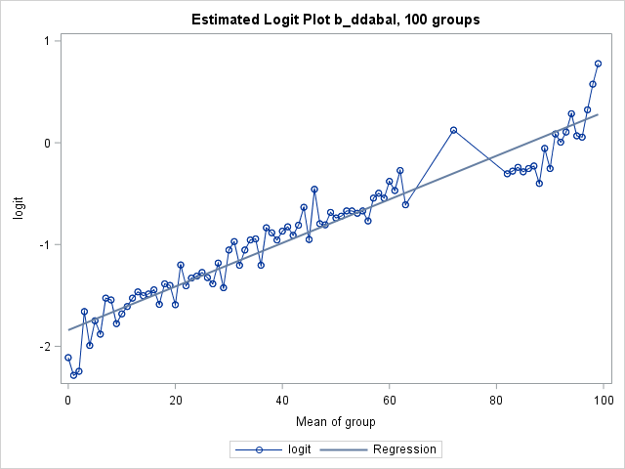
%PlotLogitsSeries(indata=d.develop_a,numgrp=100,
indepvar=b_ddabal,depvar=ins);

Slide 38
The new screened set
%let screened=
MIPhone MICCBal Dep MM ILS MTGBal Income POS CD IRA
brclus1 Sav NSF Age SavBal LOCBal NSFAmt Inv MIHMVal CRScore
MIAcctAg InvBal DirDep CCPurc SDB CashBk AcctAge InArea ATMAmt b_DDABal
DDA brclus2 CC HMOwn DepAmt Phone ATM LORes brclus4;

