Slide 1
Data splitting and cross-validation

Slide 2
In a relatively simple model like the one we fit to large amounts of data, overfitting is probably not a problem (Hand 1997).
The chance of overfitting is increased by variable selection methods that include more complex .

Slide 3
The final model, again.
%let screened=
MIPhone MICCBal Dep MM ILS MTGBal Income POS CD IRA
brclus1 Sav NSF Age SavBal LOCBal NSFAmt Inv MIHMVal CRScore
MIAcctAg InvBal DirDep CCPurc SDB CashBk AcctAge InArea ATMAmt b_DDABal
DDA brclus2 CC HMOwn DepAmt Phone ATM LORes brclus4;
ods output NObs=NObs
bestsubsets=score;
proc logistic data=d.develop_a;
model ins(event="1")=&screened resr resu
/ selection=score best=1;
run;
/*Schwarz Bayes criterion */
data _NULL_;
set NObs;
where label = 'Number of Observations Used';
call symput('obs',n);
run;
data subset;
set score;
sbc=-scorechisq+log(&obs)*(numberofvariables+1);
run;
proc sql;
select VariablesInModel into :selected
from subset
having sbc=min(sbc);
quit;
proc logistic data=d.develop_a descending plots=roc;
model ins=&selected;
run;

Slide 4
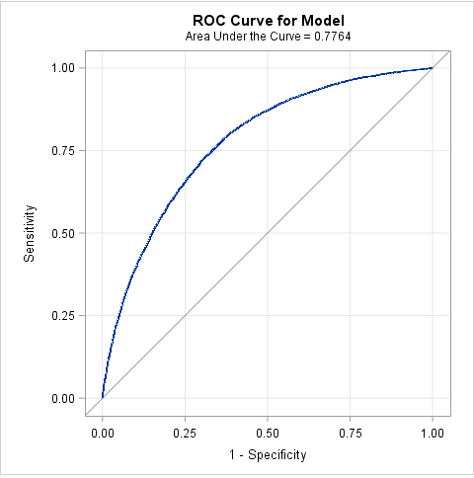
The primary purpose of data-splitting is to correct for over optimism.

Slide 5
Split the data into training and test data sets.
The training set is used for model development
The test data is used for assessment.
Most input-preparation steps can be done before
the data is split.

Slide 6
Data splitting in PROC HPLOGISTIC.
%let screened=
MIPhone MICCBal Dep MM ILS MTGBal Income POS CD IRA
brclus1 Sav NSF Age SavBal LOCBal NSFAmt Inv MIHMVal CRScore
MIAcctAg InvBal DirDep CCPurc SDB CashBk AcctAge InArea ATMAmt b_DDABal
DDA brclus2 CC HMOwn DepAmt Phone ATM LORes brclus4;
proc hplogistic data=d.develop_a;
model ins(descending)=&screened resr resu;
selection method=backward;
partition fraction(test=.25 seed=54321);
run;

Slide 7
A different partitioning
proc hplogistic data=d.develop_a;
model ins(descending)=&screened resr resu;
selection method=backward;
partition fraction(test=.25 seed=3377551);
run;

