Slide 1
Examining classifier performance.

Slide 2
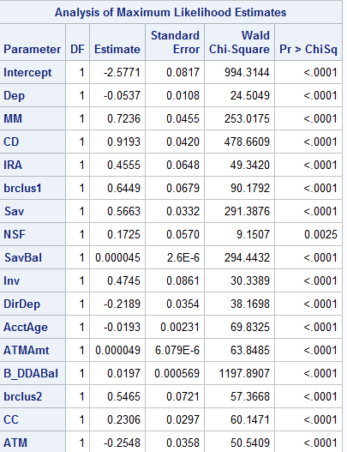
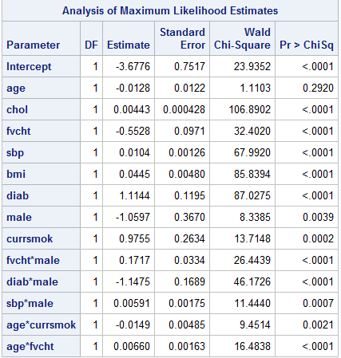
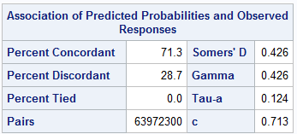
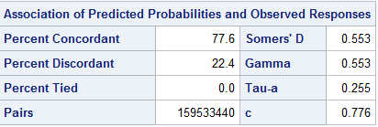

Slide 3
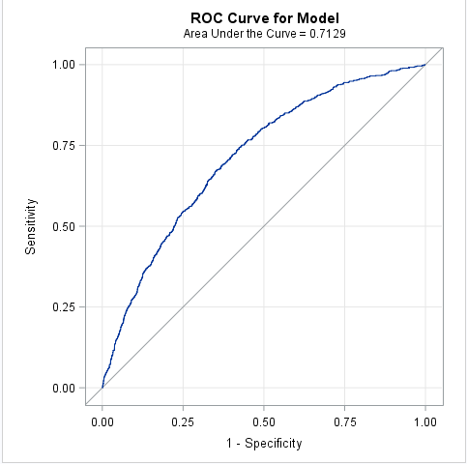
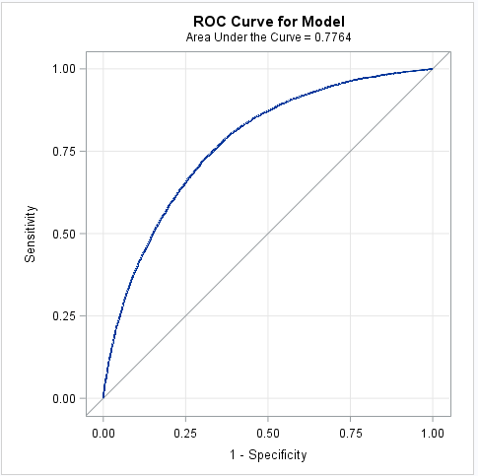
The AUROC summarizes the predictive performance at all unique thresholds.
chd2018_a
develop_a

Slide 5
Using thresholds for prediction

Slide 6
The confusion matrix.

Slide 7
The essential calculations are based on the “confusion” matrix.

Slide 8
The confusion matrix is a crosstabulation of the actual and predicted classes.
0
1
0
1
It quantifies the confusion of the classifier for a single threshold

Slide 9
Re-do the final model for the develop_a data set

Slide 10
%let screened=
MIPhone MICCBal Dep MM ILS MTGBal Income POS CD IRA
brclus1 Sav NSF Age SavBal LOCBal NSFAmt Inv MIHMVal CRScore
MIAcctAg InvBal DirDep CCPurc SDB CashBk AcctAge InArea ATMAmt b_DDABal
DDA brclus2 CC HMOwn DepAmt Phone ATM LORes brclus4;
/*do all subsets*/
ods output NObs=NObs
bestsubsets=score;
proc logistic data=d.develop_a;
model ins(event="1")=&screened resr resu
/ selection=score best=1;
run;
/*Calculate Schwarz Bayes criterion */
data _NULL_;
set NObs;
where label = 'Number of Observations Used';
call symput('obs',n);
run;
data subset;
set score;
sbc=-scorechisq+log(&obs)*(numberofvariables+1);
run;
/*select model with lowest SBC
put variable names in a macro variable*/
proc sql;
select VariablesInModel into :selected
from subset
having sbc=min(sbc);
quit;

Slide 11
Score the develop_a data set adjusting for over sampling, and define two, somewhat arbitrary, threshold predictions

Slide 12
/*run the selected model and
score the model using priorevent option*/
proc logistic data=d.develop_a descending plots=roc;
model ins=&selected;
score data=d.develop_a out=develop_scored priorevent=.02;
run;
proc univariate data=develop_scored;
var p_1;
histogram p_1;
run;
/*two arbitrary thresholds*/
data develop_scored;
set develop_scored;
yhat1=p_1 ge .05;
yhat2=p_1 ge .1;
label yhat1= "Threshold=.05"
yhat2= "Threshold=.10";
run;
proc freq data=develop_scored;
tables ins*(yhat1 yhat2);
run;

Slide 13
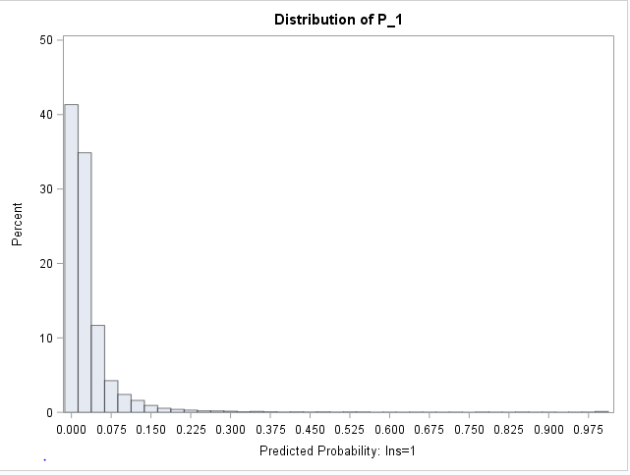

Slide 14
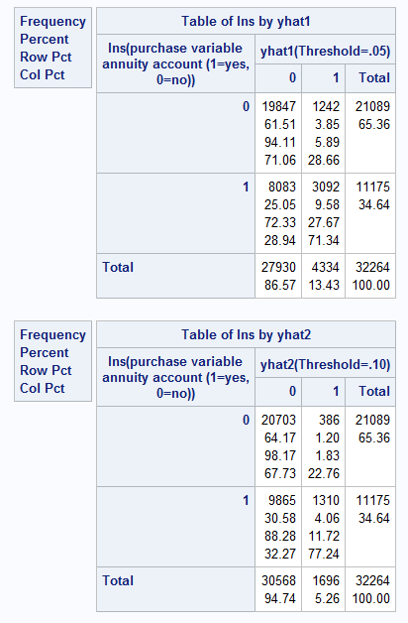

Slide 15
Three essential quantities.

Slide 16
In this case, the probability is known. It is the proportion of y=1 before oversampling

Slide 19
Some additional measures.

Slide 20
True and false positive rate

Slide 21
True and false negative rate

Slide 22
Depth

Slide 23
Positive Predicted Value -- What is the percentage of true 1’s among those we predict as 1’s?

Slide 25
Use the outroc= option in the score statement to get the essential measures.
proc logistic data=d.develop_a descending plots=roc;
model ins=&selected;
score data=d.develop_a out=develop_scored
priorevent=.02 outroc=roc;
run;
proc contents data=roc;run;

Slide 26
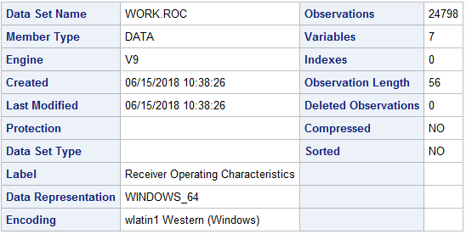
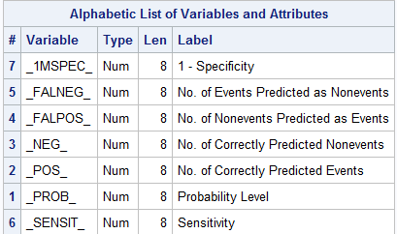

Slide 27
Calculate the measures
data roc1;
set roc(rename=(_sensit_=sensitivity _prob_=threshold));
p=.02;/*probability y=1 in original sample*/
specificity=1-_1MSPEC_;/*specificity*/
true_pos=p*sensitivity;
false_neg=p*(1-sensitivity);
true_neg=(1-p)*specificity;
false_pos=(1-p)*(1-specificity);
depth=true_pos+false_pos;
pos_pred_val=true_pos/depth;
neg_pred_val=true_neg/(1-depth);
accuracy=true_pos+true_neg;
lift=pos_pred_val/p;
drop _1mspec_ _FALNEG_ _FALPOS_ _neg_ _pos_;
run;
proc contents data=roc1;run;

Slide 28
A Gains chart. Plot positive predicted value vs depth
proc sgplot data=roc1;
/*restict to a reasonable range of probabilities to consider*/
where threshold > .005 and threshold<.5;
title "Gains Chart";
title2 "Plot positive predicted value vs depth";
series x=depth y=pos_pred_val/ lineattrs=(thickness=2);
refline 1/axis=y;
run;
title;

Slide 29
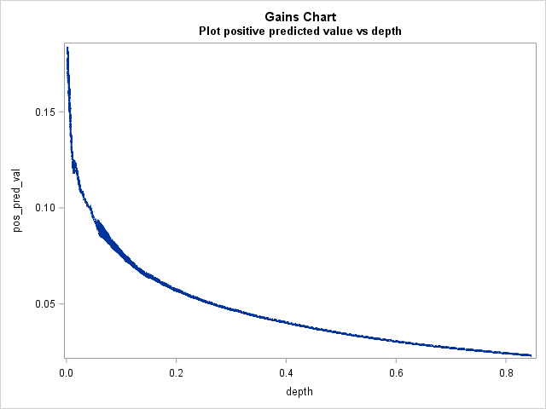

Slide 30
Lift chart – plot lift vs depth
proc sgplot data=roc1;
/*restict to a reasonable range of probabilities to consider*/
where threshold > .005 and threshold<.5;
title "Lift Chart";
title2 "Plot lift vs depth";
series x=depth y=lift/ lineattrs=(thickness=2);
yaxis values=(0 to 7 by 1);
refline 1/axis=y;
run;
title;

Slide 31
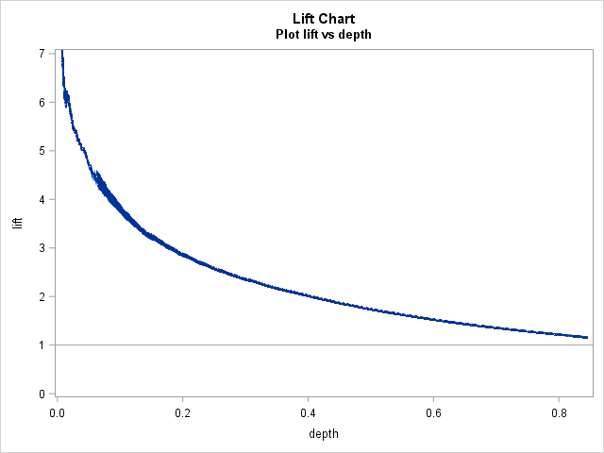

Slide 32
Ideally, one would like large values of all these statistics. The context of the problem determines which of these measures is the primary concern.
A database marketer might be most concerned with PV+ because it gives the response rate for the customers that receive an offer.
A fraud investigator might be most concerned with sensitivity because it gives the proportion of frauds that would be detected.

