Slide 1
5
Determining Optimal Thresholds

Slide 2
Different cutoffs produce different allocations and different confusion matrices.
To determine the optimal cutoff, a performance criterion needs to be defined.
If the goal were to increase the sensitivity of the classifier, then the optimal classifier would allocate all cases to class 1.
If the goal were to increase specificity, then the optimal classifier would be to allocate all cases to class 0.
For realistic data, there is a trade-off between sensitivity and specificity. Higher cutoffs decrease sensitivity and increase specificity. Lower cutoffs decrease specificity and increase sensitivity.

Slide 3
Profit matrix

Slide 4
Profit Matrix
Total Profit
70
5
Predicted
16*99 - 5 = $1579
9
16
0
1
0
$0
-$1
66
9
Actual
21*99 - 9 = $2070
1
$0
$99
4
21
57
18
24*99 - 18 = $2358
1
24

Slide 5
The decision-theoretic approach starts by assigning profit margins to true positives and loss margins to false positives. The optimal decision rule minimizes the total expected profit.
The profit matrix in the above slide is consistent with a marketing effort that costs $1, and, when successful, garners revenue of $100. Hence, the profit for soliciting a non-responder is -$1, and the profit for soliciting a responder is $100-$1 = $99. Given that each individual has a posterior probability p_{i}, you can resort to simple algebra to find the optimum cutoff.
A typical decision rule would be: Solicit if the expected profit for soliciting, given the posterior probability, is higher than the expected profit for ignoring the customer.
Solicit if:
E(Profit | p_{i}, solicit) | > | E(Profit | p_{i}, do not solicit)
p_{i}*99 + (1-p_{i})*(-1) | > | p_{i}*0 + (1-p_{i})*(0)
99*p_{i} -1 + p_{i} | > | 0
100*p_{i} -1 | > | 0
p_{i} | > | 0.01.
The cutoff of 0.01 can be used to calculate the expected profit of using this rule with the current model.

Slide 6
Profit Matrix
Decision
Bayes Rule:
Decision 1 if
0
1
0
Actual Class
1

Slide 7
The Bayes rule is the decision rule that maximizes the expected profit. In the two-class situation, the Bayes rule can be determined analytically. Using the symbols in the above profit matrix, if a customer is solicited then the expected profit is
where p is the true posterior probability that a case belongs to class 1. If a customer is not solicited then the expected profit is
Therefore, the optimal rule allocates a case to class 1 if
The optimal rule allocates a case to class 1 if
otherwise allocate the case to class 0.

Slide 8
Solving for p gives the optimal cutoff probability. Because p must be estimated from the data, the plug-in Bayes rule is used in practice
The plug-in Bayes rule may not achieve the maximum profit if the estimate of the posterior probability is poorly estimated.

Slide 9
Using the profit matrix defined earlier, the optimal cutoff becomes

Slide 10
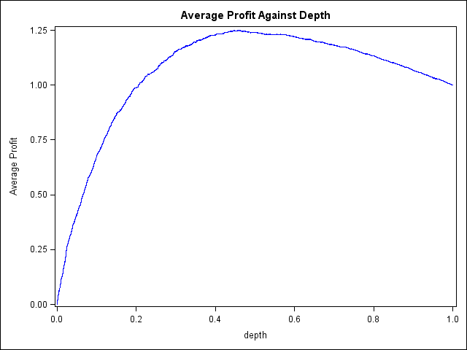
Using Profit to Assess Fit

Slide 11
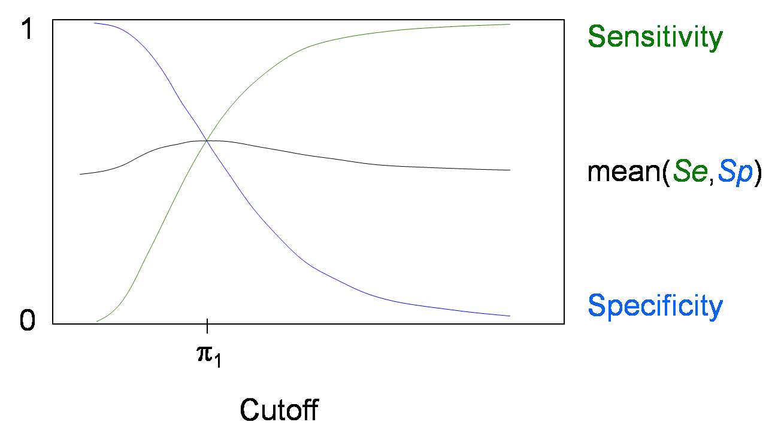
Profit information can be difficult to come by.
One possibility is to use a cutoff of π_{1.}
The central cutoff, π₁, tends to maximize the mean of sensitivity and specificity. Because increasing sensitivity usually corresponds to decreasing specificity, the central cutoff tends to equalize sensitivity and specificity.
If separate samples were taken with equal allocation (50% events and 50% nonevents), then using the unadjusted cutoff of 0.5 on the biased sample is equivalent to using the central cutoff, π₁, on the population.

